Slide 1
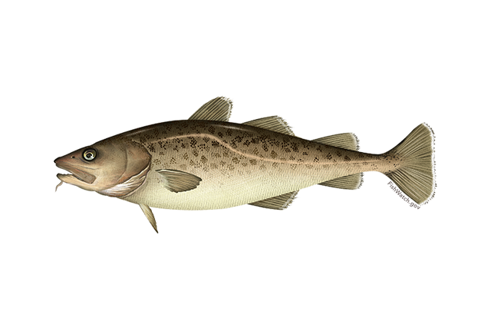

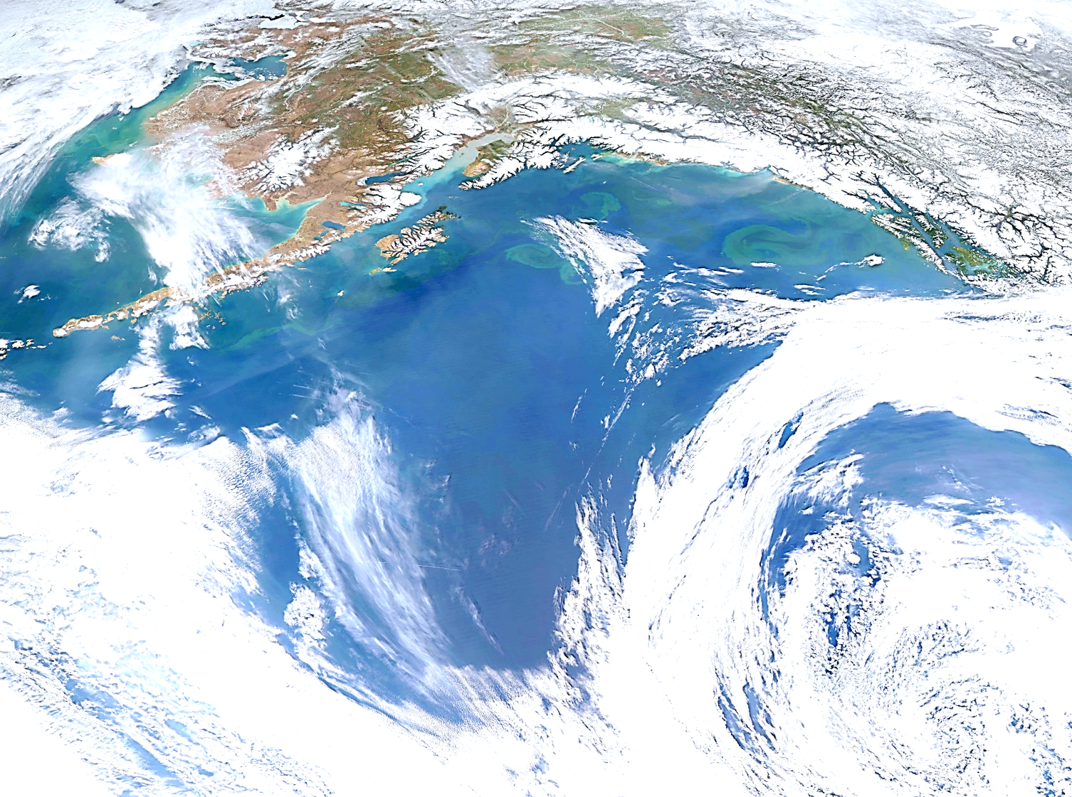
Goa pacific cod
Pete hulson, steve barbeaux, bridget ferriss, Susanne mcdermott, and Ingrid spies – november 2022

Slide 2
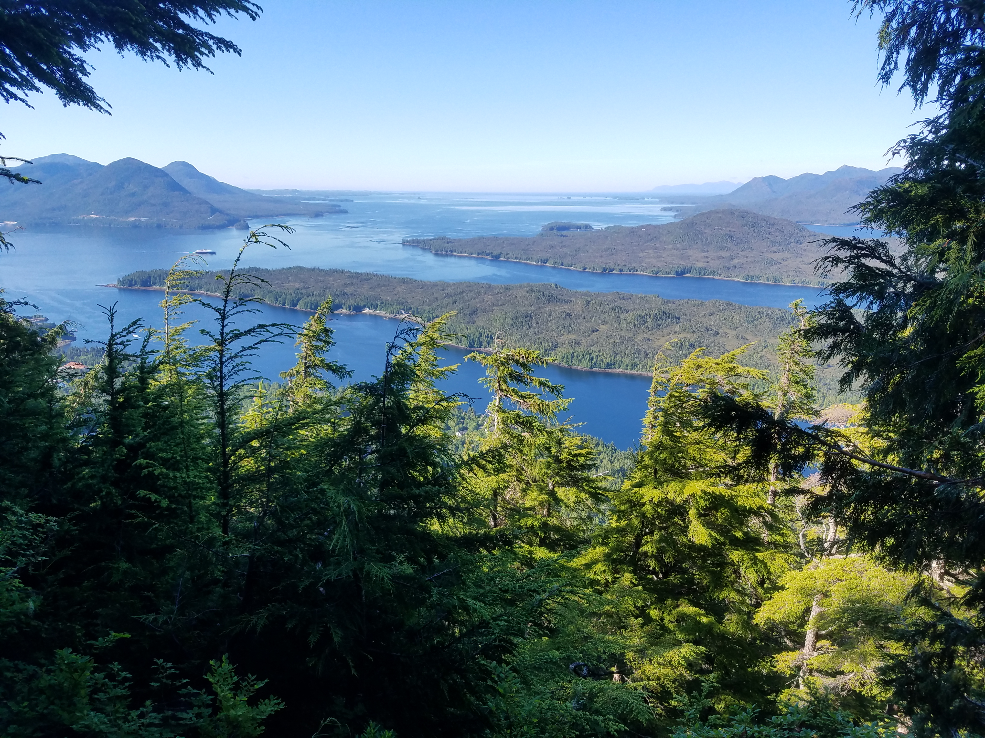
Stock overview
Tier(s)
Area(s)
Current year status
BRIEF summary of changes to the current assessment data/model
PT/SSC comments being addressed IN THIS PRESENTATION ONLY

Slide 3
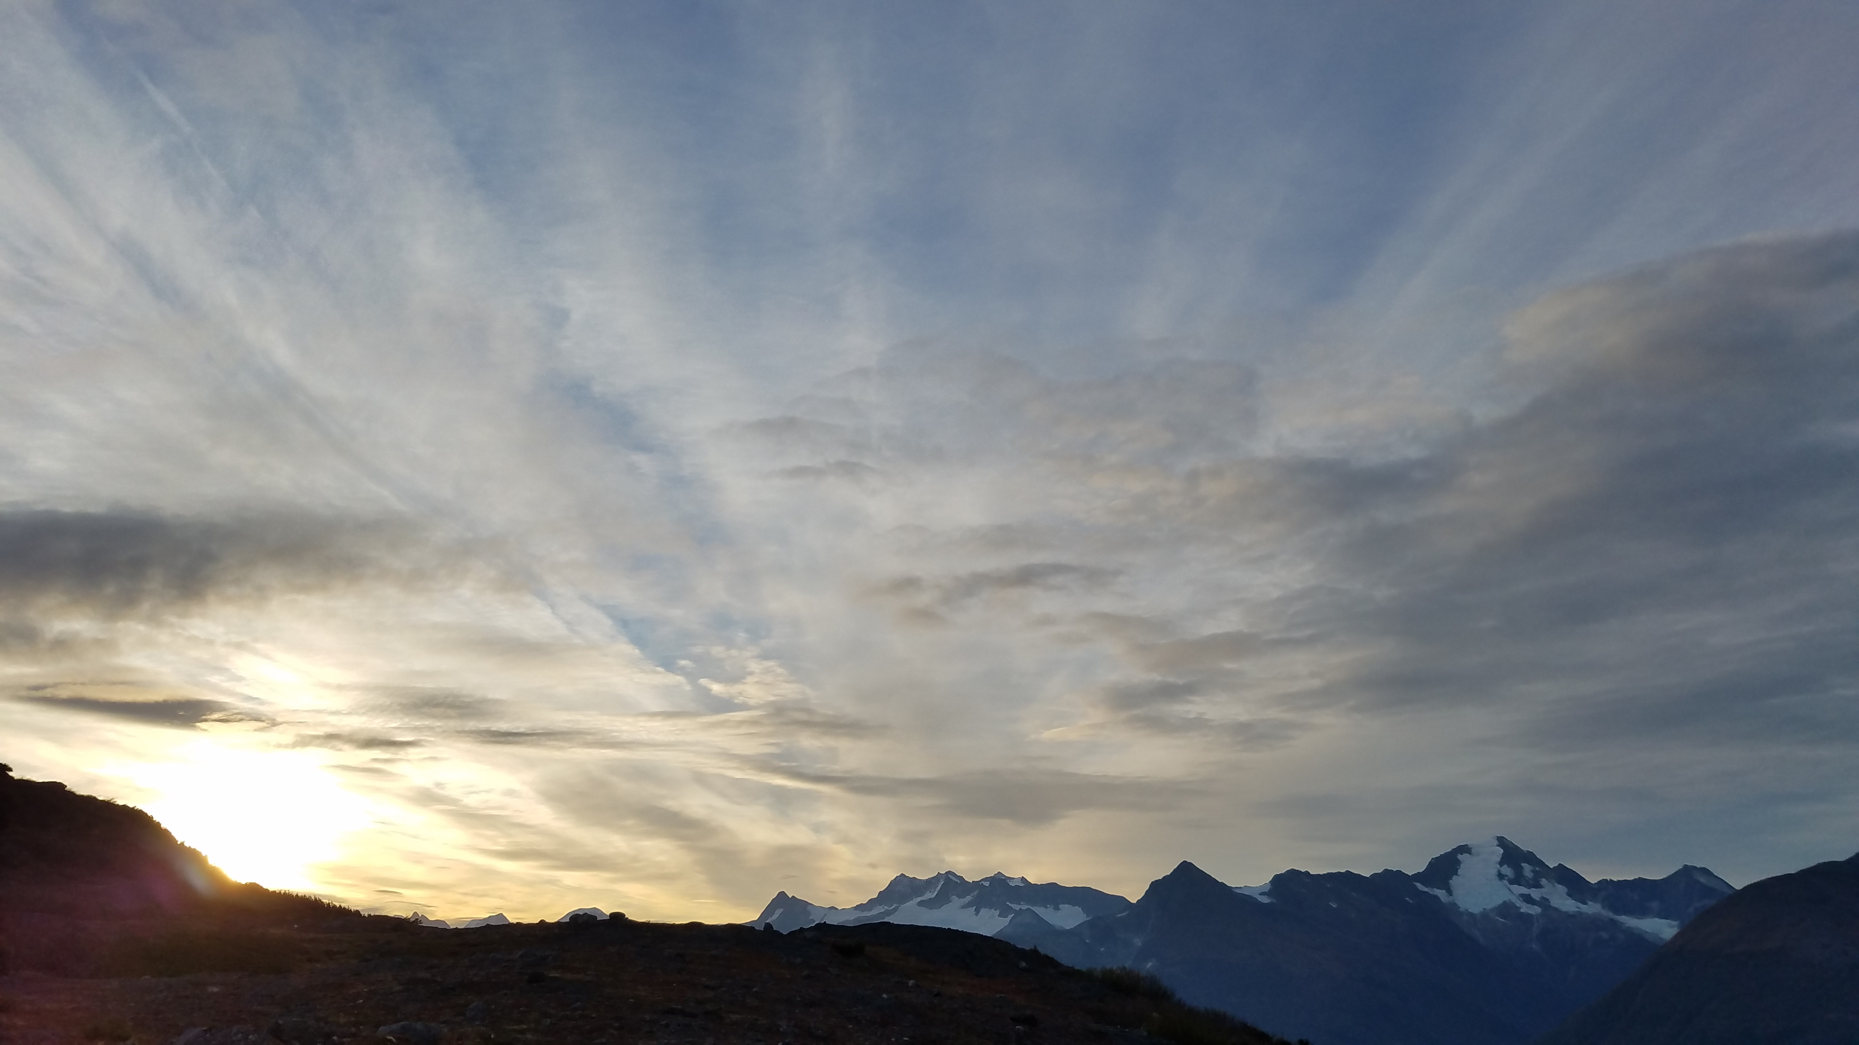
Catch
Updated catch
Highlight any issues with catch data
Overages
Data issues
Discards
Multiple slides can be used if necessary. Layout can be changed.

Slide 4

Catch
Updated catch
Highlight any issues with catch data
Overages
Data issues
Discards
Multiple slides can be used if necessary. Layout can be changed.

Slide 5
Biomass
Updated survey biomass
Highlight any issues with survey data
Patchy distribution
Reduced stations?
Changes in distribution, especially within a complex
Multiple slides can be used if necessary. Layout can be changed.

Slide 6
Models - overview
Tier X
Tier Y
Layout can be changed.
Model description
Model description

Slide 7
Models - results
Tier X
Tier Y
Multiple slides can be used. Layout can be changed.
RFX biomass
RFX biomass

Slide 8
Models - results
Tier X
Tier Y
Multiple slides can be used. Layout can be changed.
M
Weighted M

Slide 9
Models - results
Summary table of Tier 6 harvest recommendations
Multiple slides can be used if necessary. Layout can be changed.

Slide 10
Harvest recommendations
Summary table of all tiers harvest recommendations, may be broken out as necessary
Compare to previous assessment
Multiple slides can be used. Layout can be changed.

Slide 11
Area allocation
Summary table apportioned ABCs
Compare to previous assessment
Layout can be changed.

Slide 12
Risk table
When last completed
Key findings in last update
Any recommended reductions
Layout can be changed.

Slide 13
conclusions
Final table out of exec summary
DO NOT include research updates, only information pertinent to the ABC decisions
Multiple slides can be used if necessary.

